Slide 1
Meeting Week 19
Last week summary
Compare data between systems
  With and without added MSD
Encoder
Outline ToDo next week

Slide 2
Last week summary
Discussed encoder
  Neural network for estimating initial states for a small window of the trajectory

Slide 3


Slide 4


Slide 5

Lagrange-Euler - Garcia

Slide 6

Lagrange-Euler - Garcia

Slide 7
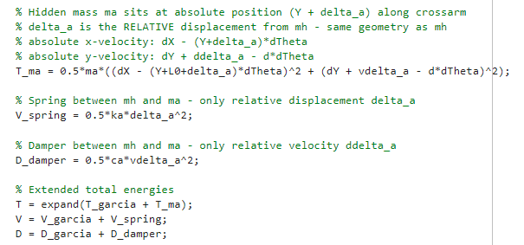
Lagrange-Euler – Additional state
Only added offset L0

Slide 8
Results verified against simscape
System with MSD vs Simscape with MSD
RMSE X1 : 2.4919e-07 m
RMSE X2 : 1.6463e-07 m
RMSE Y : 5.0275e-09 m
System without MSD vs Simscape with MSD
RMSE X1 : 4.4957e-07 m
RMSE X2 : 2.9607e-07 m
RMSE Y : 7.6171e-09 m
For ASMPT it was required that the formulas for the additional state are correct

Slide 9
Update: verify augmented model against simscape
Offset was incorrect in simscape model
Previous in range e^-7 both models

Slide 10
Correction simscape model
Offset not properly connected
RMSE of system with MSD vs Simscape with MSD
RMSE X1 : 5.4695e-09 m
RMSE X2 : 4.3447e-09 m
RMSE Y : 8.5888e-10 m
RMSE of system without MSD vs Simscape with MSD
RMSE X1 : 1.9981e-07 m
RMSE X2 : 1.3203e-07 m
RMSE Y : 6.0441e-09 m
Now same error range as original baseline vs original simscape model
Clear difference between baseline and augmented system (MSD)

Slide 11
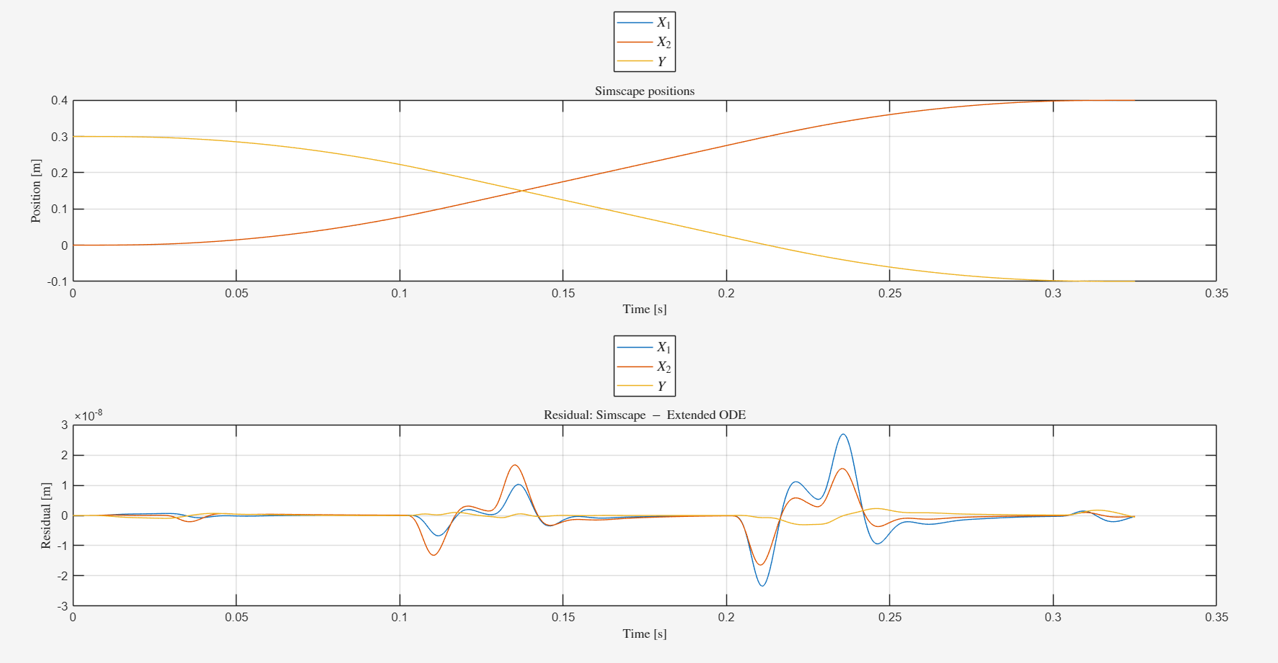

Slide 12
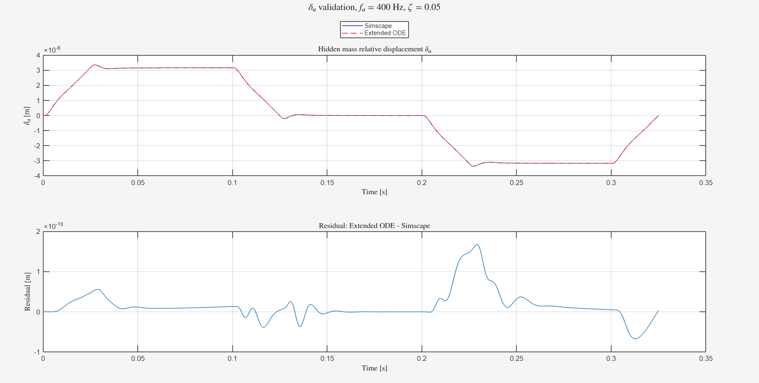

Slide 13
Baseline vs augmented system
Is the added MSD to the payload observable in our data
FRF comparison
  Closed-loop
  Plant

Slide 14
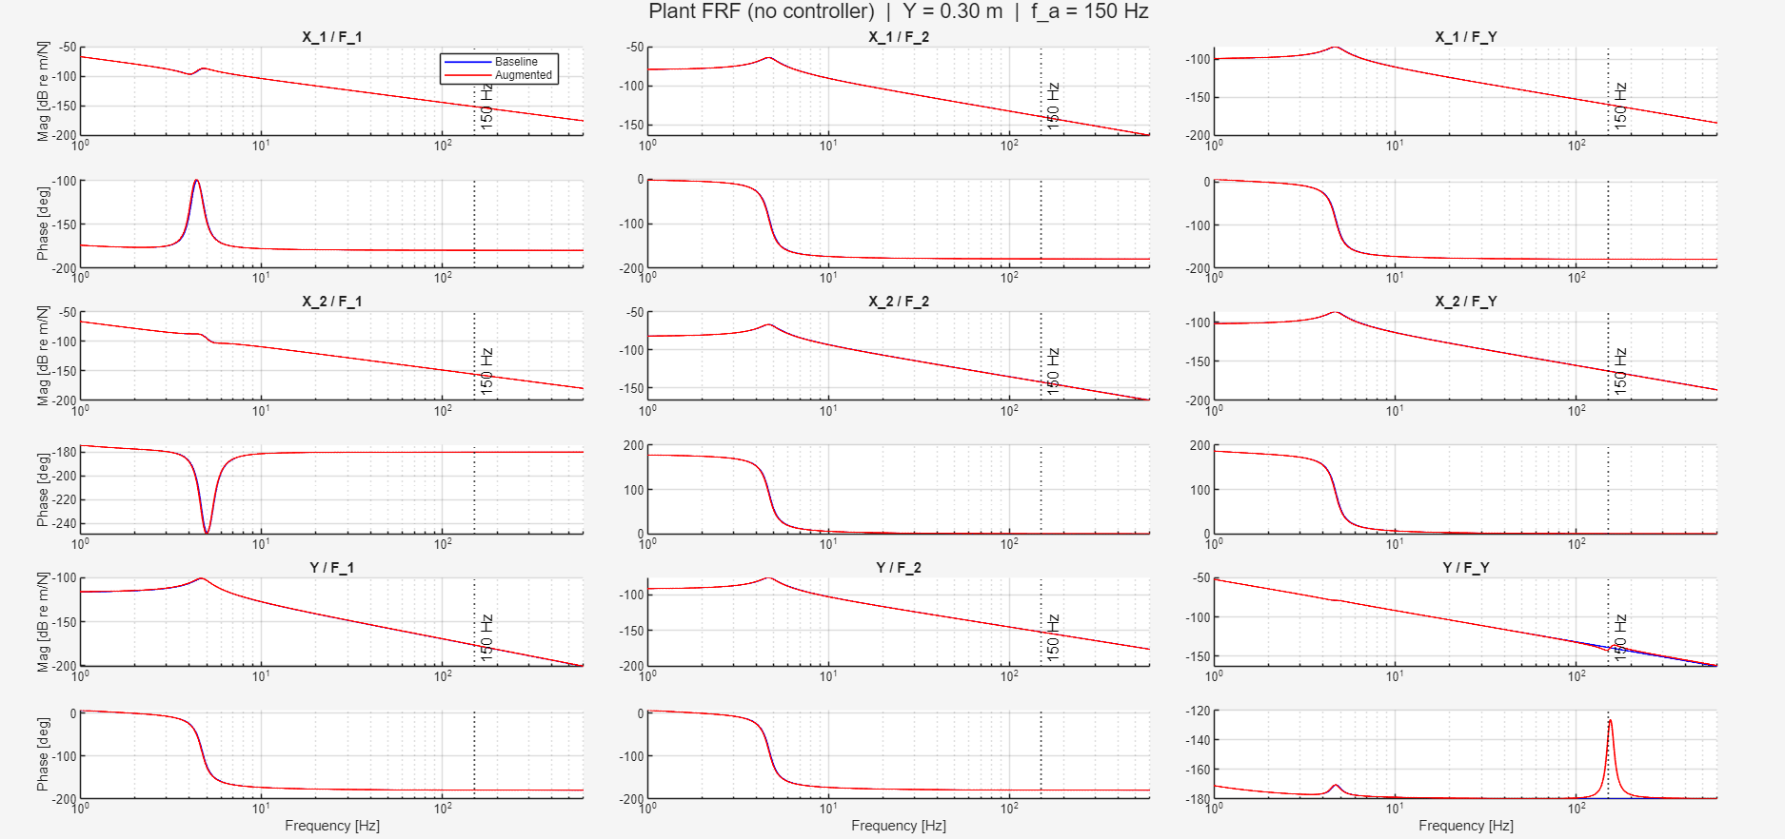

Slide 15
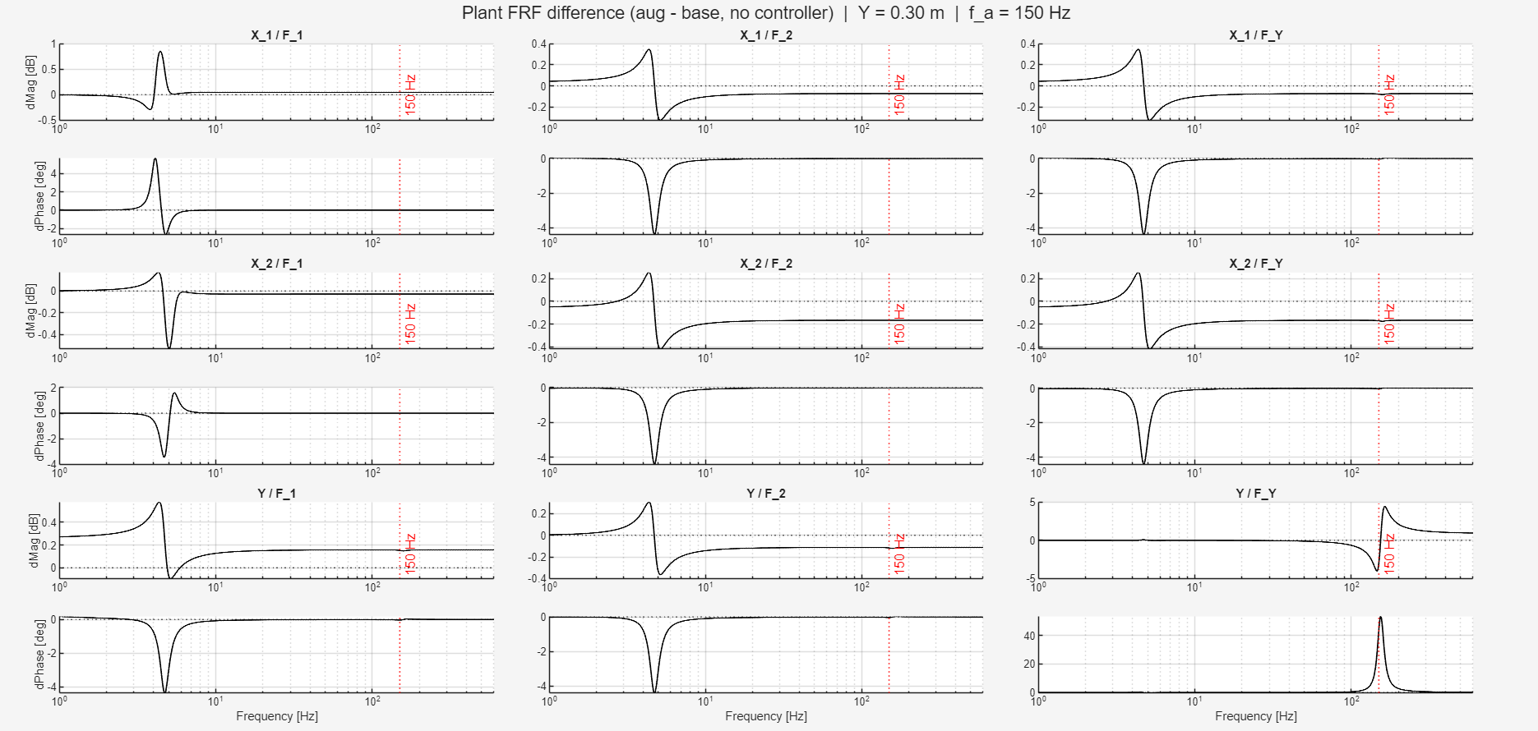

Slide 16
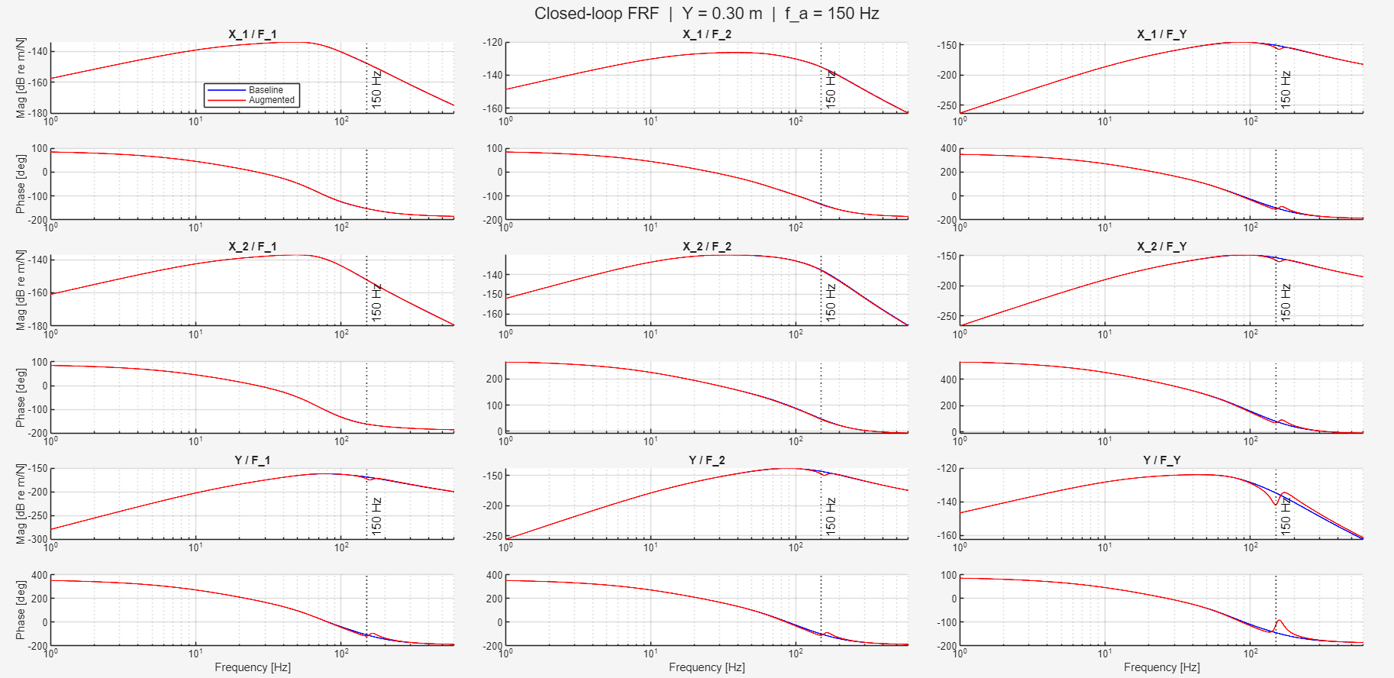

Slide 17
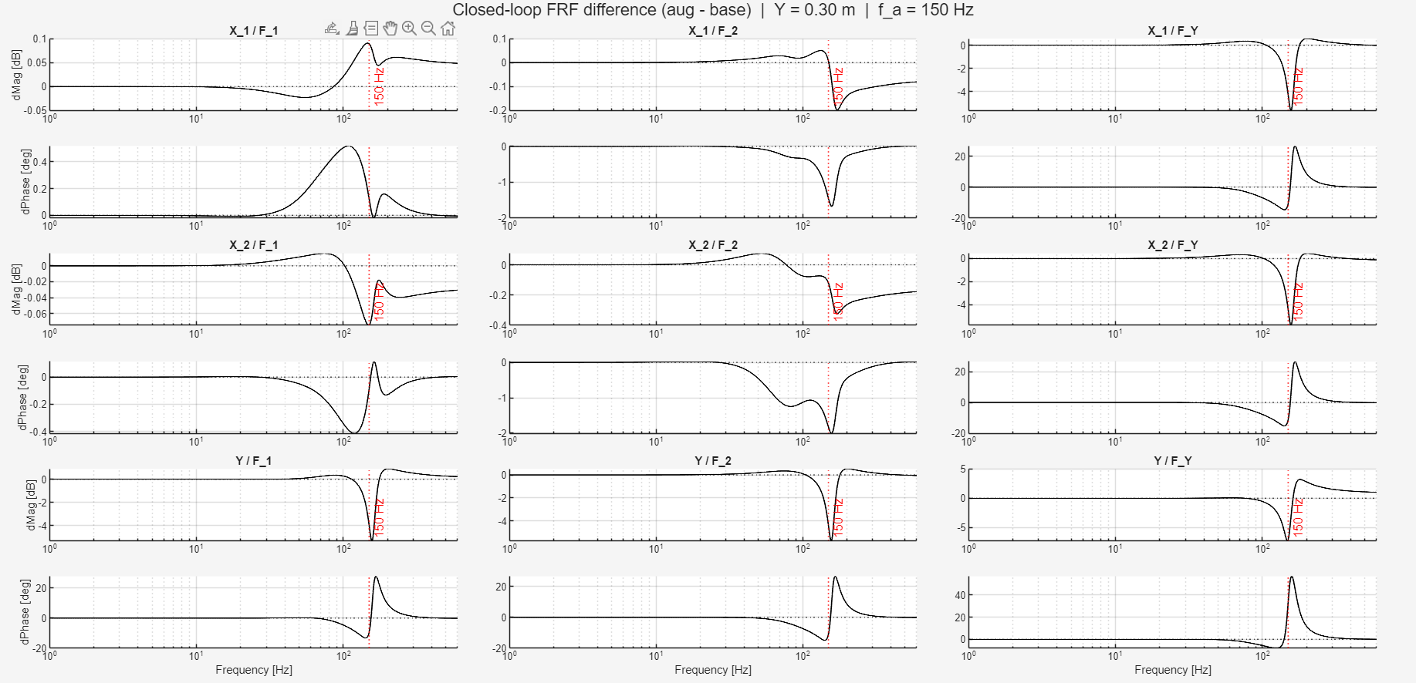

Slide 18
Error between baseline and augmented
Given the same input from closed-loop augmented system to the baseline system.
  What is the difference
Why:
  Want to know whether the baseline model given the input from the augmented system

Slide 19
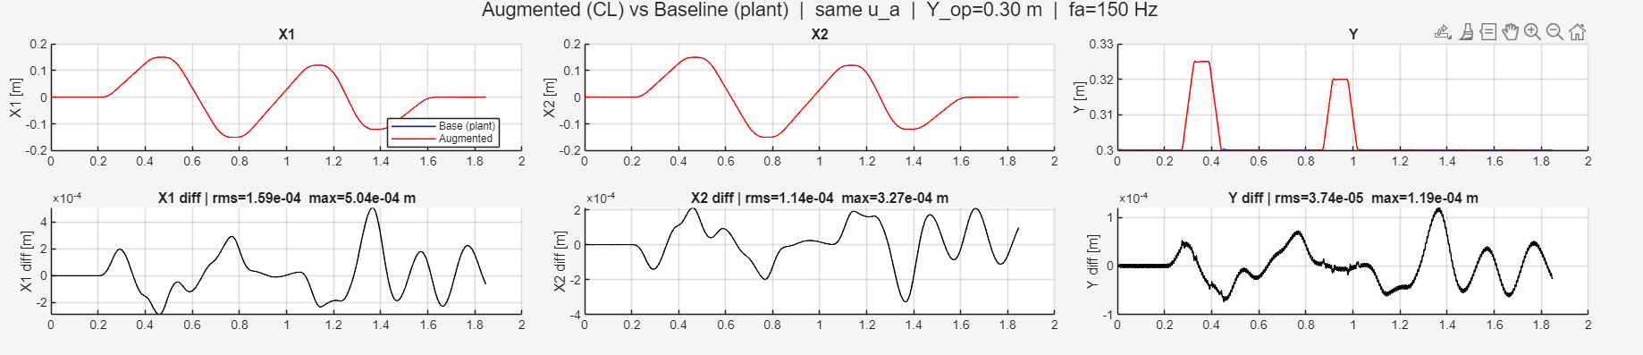
System with added MSD vs system without MSD
  Used the same input, compared the difference
Parameter recovery was able to get in the range e^-7
  With perfect parameters / perfect model is able to get in that range
  We have no noise currently

Slide 20
Verify gantry model implementation
Why:
  Wanted to verify model implementation in code structure
  Also see the effects of LTI against LPV, to justify whether LPV will dominate error or not
    For augmentation to be able to capture additional states
    Only “small” Y-movements because the current model is LTI, need to know if this information is informative
      Compared to data used in parameter recovery (now LTI)

Slide 21
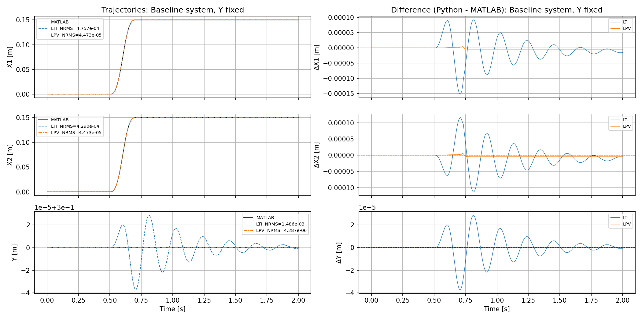
Notes:
1. State normalization — z-score with mean subtraction
x_norm = (x_phys - x_mean) / std_x
2. Input normalization — scaling only, no mean subtraction
u_norm = u / std_u
3. State derivative normalization (inside Gantry_State_Block)
xdot_norm = xdot_phys / std_x

Slide 22
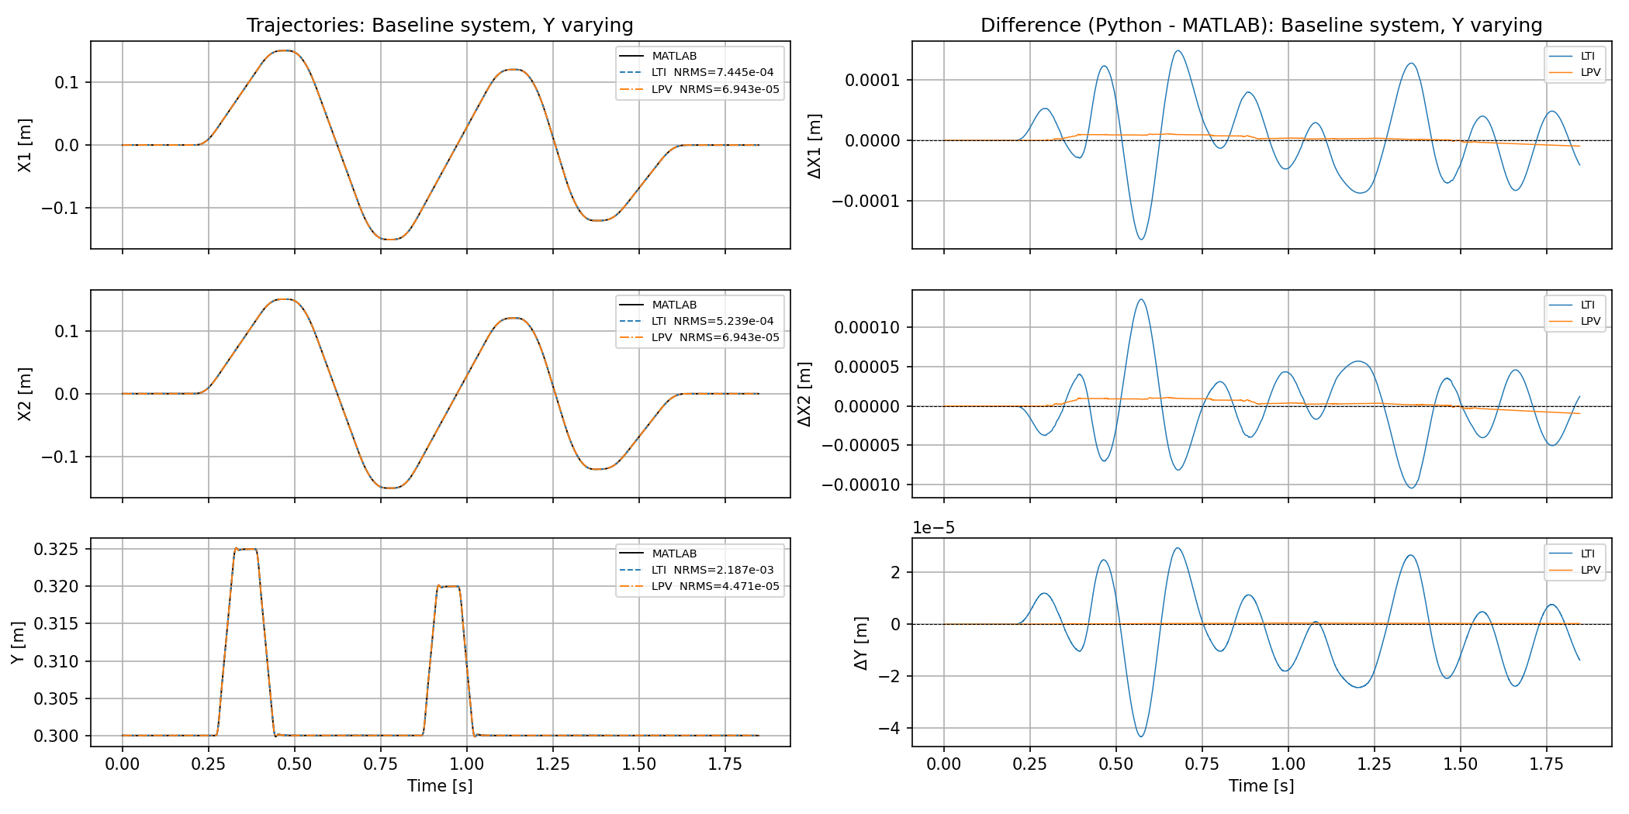
Notes:
1. State normalization — z-score with mean subtraction
x_norm = (x_phys - x_mean) / std_x
2. Input normalization — scaling only, no mean subtraction
u_norm = u / std_u
3. State derivative normalization (inside Gantry_State_Block)
xdot_norm = xdot_phys / std_x

Slide 23
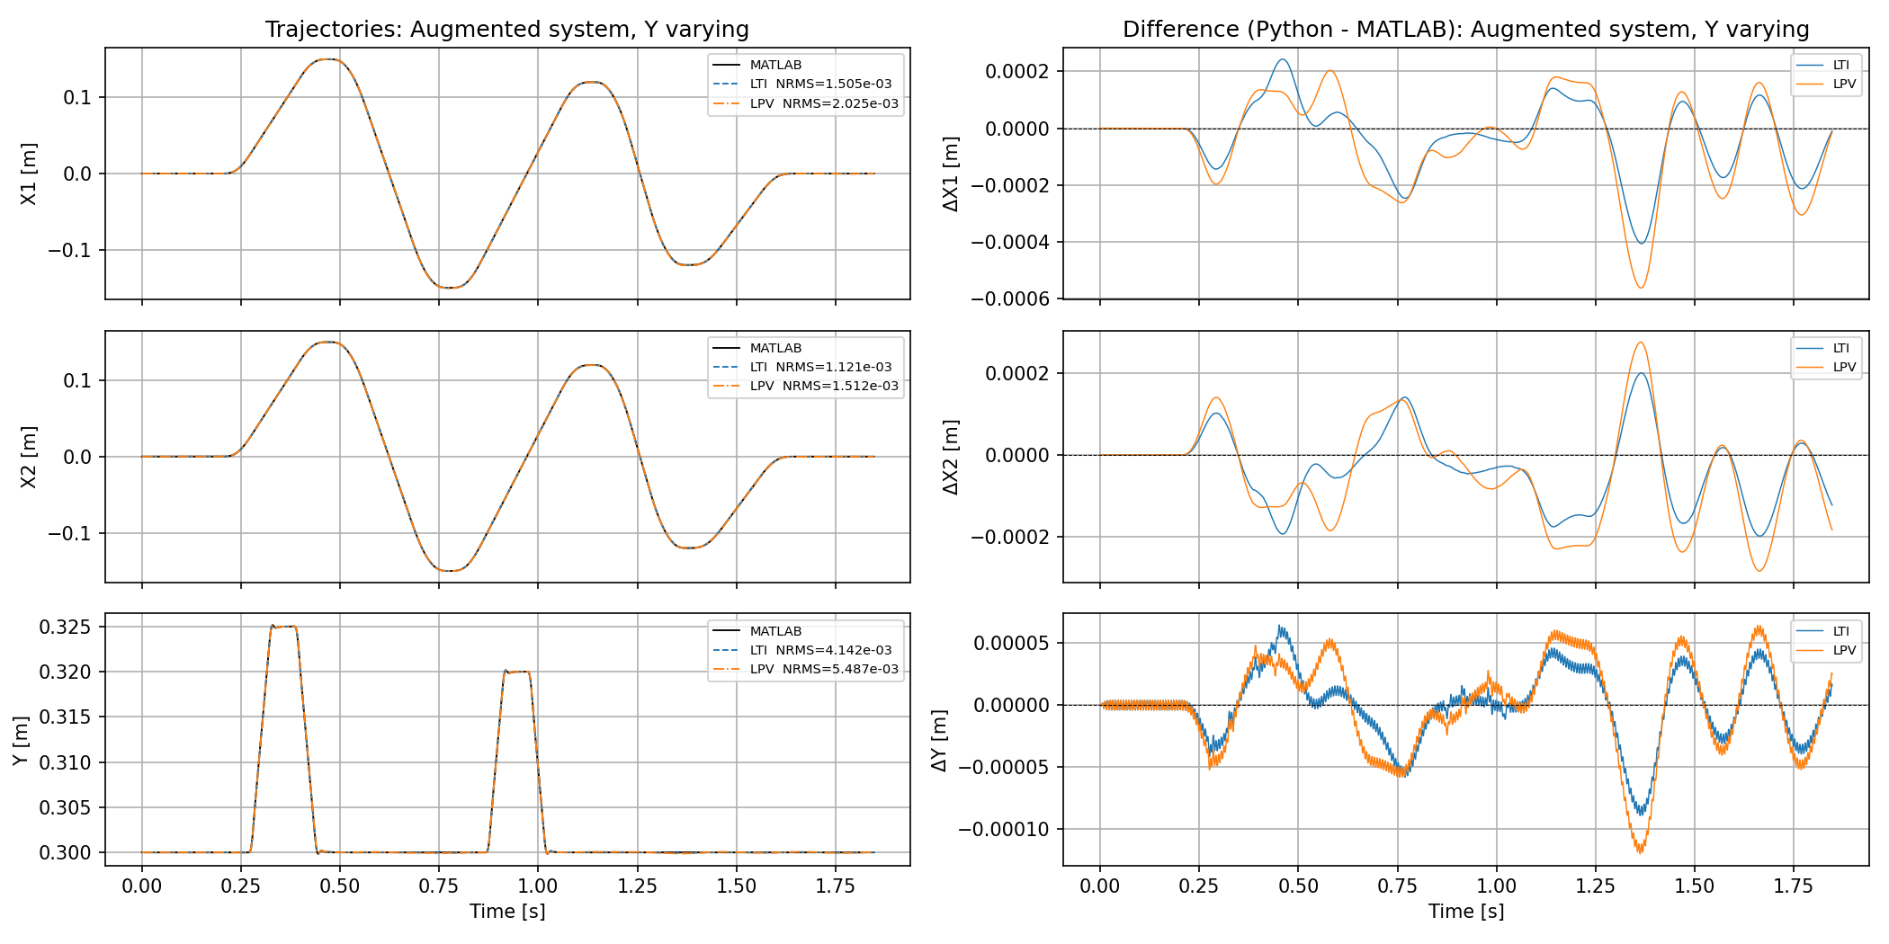
Notes:
1. State normalization — z-score with mean subtraction
x_norm = (x_phys - x_mean) / std_x
2. Input normalization — scaling only, no mean subtraction
u_norm = u / std_u
3. State derivative normalization (inside Gantry_State_Block)
xdot_norm = xdot_phys / std_x

Slide 24
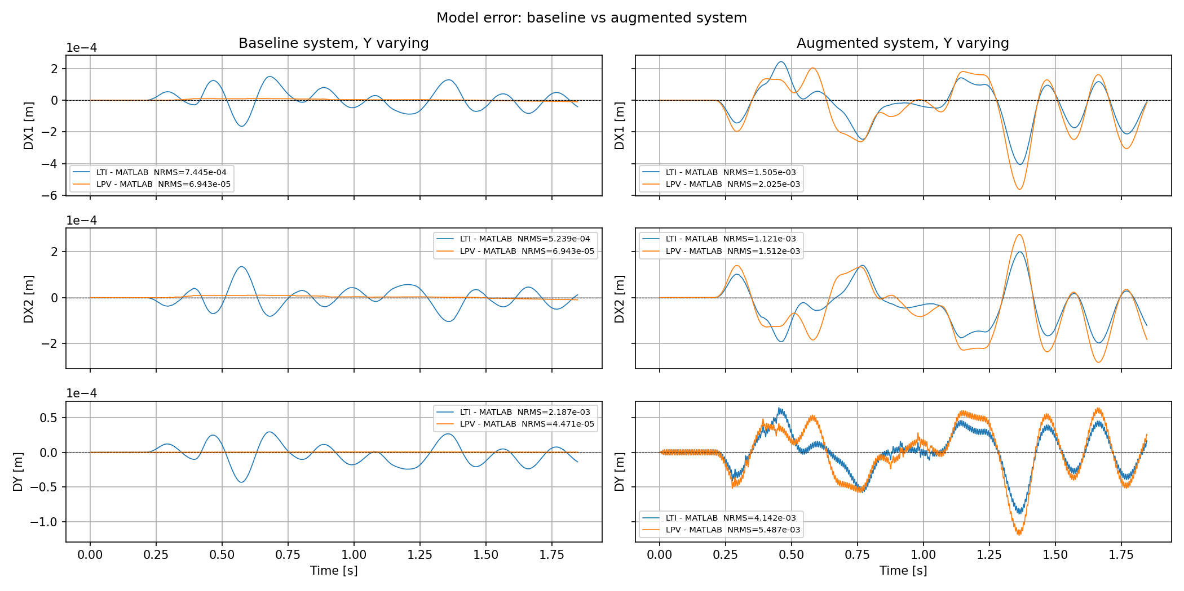
Notes:
1. State normalization — z-score with mean subtraction
x_norm = (x_phys - x_mean) / std_x
2. Input normalization — scaling only, no mean subtraction
u_norm = u / std_u
3. State derivative normalization (inside Gantry_State_Block)
xdot_norm = xdot_phys / std_x

Slide 25
Currently one trajectory only
No LPV implementation kept at one Y-operating point
The MSD is attached to the Y-beam
  Will first have to implement LPV before augmentation (dynamic parallel) of the additional state

Slide 26
Encoder
Estimates where the gantry is and how fast it’s moving at the start of the trajectory
Compare:
  Encoder-init: simulation started from the encoder's estimated position/velocity
  Zero-state: simulation started from rest at the origin

Slide 27
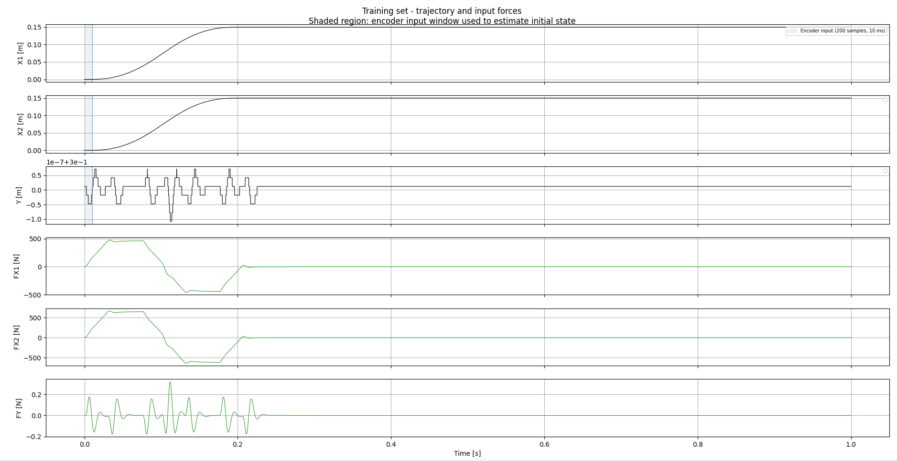

Slide 28
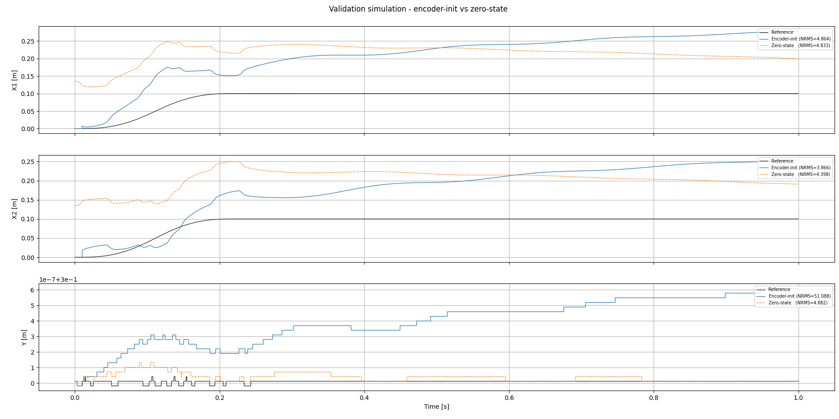

Slide 29
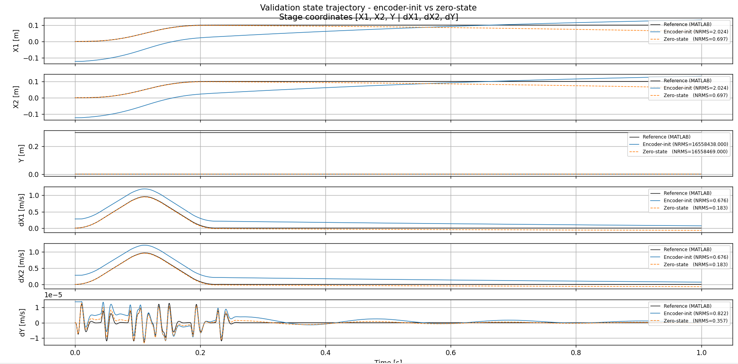

Slide 30
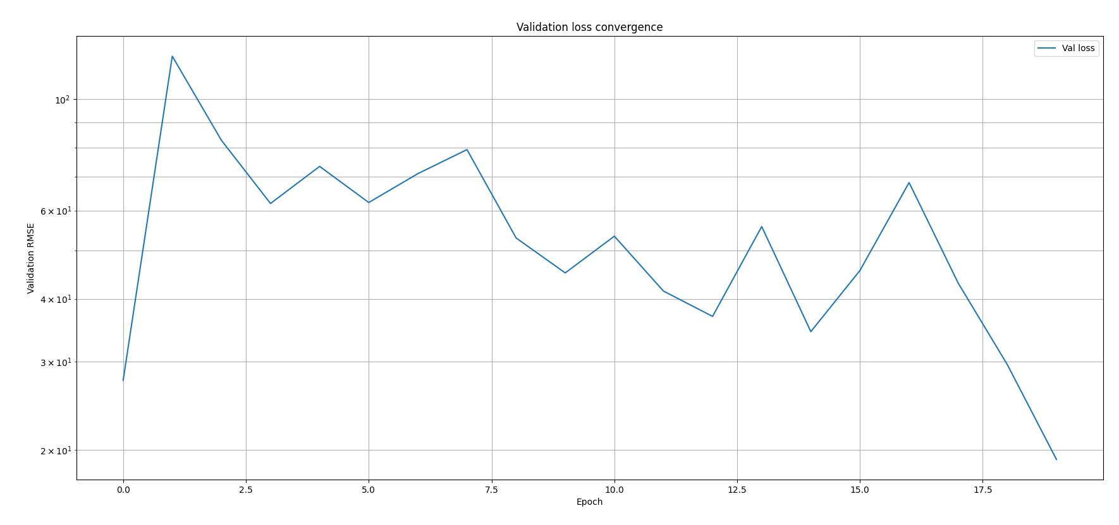
Ran for 50 epochs, but saved up till the best epoch

Slide 31
Encoder mimo data verification
What after… dynamic parallel…? Lpv? I need LPV to excite the MSD, so…

Slide 32
Frf voor sample length etc

Slide 33
- The FAIL is not a model failure. The encoder slightly
miscalibrates the Y initial condition, which has negligible
physical effect (~microns), but dividing by near-zero std makes
it look catastrophic
For Phase 1, report X1 and X2 only, and explicitly note that Y
is excluded because it is frozen (zero variance, NRMS is not a
meaningful metric). The actual research result is:

Slide 34
gantry_subnet_verification.py
------------------------------
Verify that the full SSE_Interconnect pipeline (encoder + Gantry_State_Block +
Linear_Output_Block) trains correctly on matched MATLAB data (Phase 1).

Slide 35
RK4 implementation of continuous model
1. Gantry_State_Block — the core contribution. A
physics block for the 3-DOF gantry with
LFR-structured RK4 integration.

Slide 36
Currently one trajectory Y does not move no lpv model treated as LTI (one Y-operating point)

Slide 37
Show plots encoder
What does the encoder do; explain
Plot of validation? Plot of trajectory + input forces

Slide 38
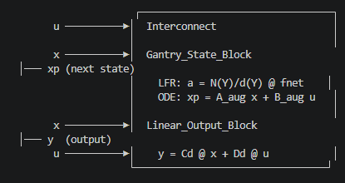
The wiring calls (connect_signals,
connect_block_signals) tell the Interconnect which named
signals to feed into each block's inputs. At runtime,
interconnect(x, u) executes all blocks in order and
returns (y, x_next).
SSE_Interconnect wraps this: it adds an encoder network
on top. During training, the encoder maps (u_past,
y_past) → x̂₀, then the interconnect rolls forward for NF
steps. The loss is the BPTT error over those steps.

Slide 39
Lists problems to be careful for, for LPV
Jacobian
…
State estimation..?

Slide 40
Question 1
If a question needs to be answered. Make clear here what the problem/question is that needs to be answered. Questions can always be asked outside the meeting, but we may say prepare to explain what you really mean.
Some figure explaining the concept
When applicable, the same as will go in final report. Otherwise just take screenshots from relevant papers.

Slide 41
Should I add the velocities as states?
Encoder becomes better because…
Does the system save these?

Slide 42
Float64 compared against float32
but I save matlab files as float32

Slide 43
Kijken Kleine hoek parameter recovery

Slide 44
Cpu vs gpu

Slide 45
Kijken of ik een script heb voor LPV verifiëren door hele interconnect etc.

Slide 46
Augmentation difference static and parallel
Know x_tilde

Slide 47
The encoder exists because of how the training works:
The core problem: Jan's framework trains via multi-step rollout (BPTT). To roll out y_hat,
x_next = hfn(x, u) for nf steps, you need an initial state x0. But you never measure the full
state directly, you only have input/output measurements (u, y).
Why you can't just use the analytical baseline during training:
1. Velocities from finite differences are noisy and only approximate the true state
2. ANN states have no physical meaning, so there's no analytical way to set them. Zero is just
a guess.
3. Most importantly: x0 needs to be differentiable with respect to the network parameters. A
fixed analytical x0 is a constant, so gradients from the rollout loss can't improve the
initialization. The encoder is a neural network, so it's part of the computation graph and
gradients flow through it.
In short: the encoder solves the state reconstruction problem, mapping (u_past, y_past) → x0,
in a way that is:
- Learned from data (adapts to the actual system)
- Differentiable (enables end-to-end BPTT training)
- Complete (estimates both physical states and ANN latent states)
Without it, every rollout window would start from a suboptimal, non-differentiable guess, and
the ANN augmentation states would always start at zero. The encoder lets the model "warm up"
its internal state from measurement history before predicting forward.
Benefit encoder

Slide 48
Good question. The encoder doesn't get evaluated on how well it
estimates x0 directly. There's no ground truth for x0 to
compare against (especially not for the ANN states).
Instead, the evaluation is indirect, via rollout quality:
1. Encoder produces x0 from the past I/O window
2. We roll forward from that x0 for nf=350 steps using hfn(x,
u) with the actual future inputs
3. The rolled-out output y_hat (positions X1, X2, Y) is
compared against the measured output y_ref
4. RMS = sqrt(mean((y_hat - y_ref)^2))
So the RMS is purely on the output prediction error over the
rollout horizon, not on the state estimate itself. A good x0
produces a rollout that tracks the measured output well; a bad
x0 causes the rollout to drift.
This is why the analytical baseline comparison is meaningful:
if you initialize with (measured positions, finite-diff
velocities, ANN=0) and roll forward, you get some output error.
If the encoder's x0 produces a rollout with less output error,
the encoder is doing something useful, likely estimating
better velocities and/or non-zero ANN states that improve the
prediction.
You never directly compare encoder states to "true" states
because there is no ground truth state, only ground truth
outputs.

Slide 50
What is the encoder?
neural network that maps past I/O history (u_past, y_past) to an initial state x0
x0 contains both physical states (positions, velocities) and
ANN augmentation states

Slide 51
Why do we need it?
BPTT training rolls out the model for i-amount of steps from an initial state x0, but we only measure outputs (positions), not the full state
Analytical alternative positions from measurements, velocities from finite differences, ANN states = 0
ANN augmentation states have no physical meaning
Notes:
is not differentiable, so gradients cannot improve x0 during training

Slide 52
How do we evaluate it?
Data from system with added MSD
Evaluate indirectly: roll forward i steps from x0 through the full augmented model and compare predicted output y_hat against measured output y_ref over the rollout horizon
Compare encoder-initialized rollouts against analytical baseline rollouts (same trained model, different x0)
Analytical baseline: x0 = [measured positions, finite-diff velocities, 0 for ANN states]

Slide 53
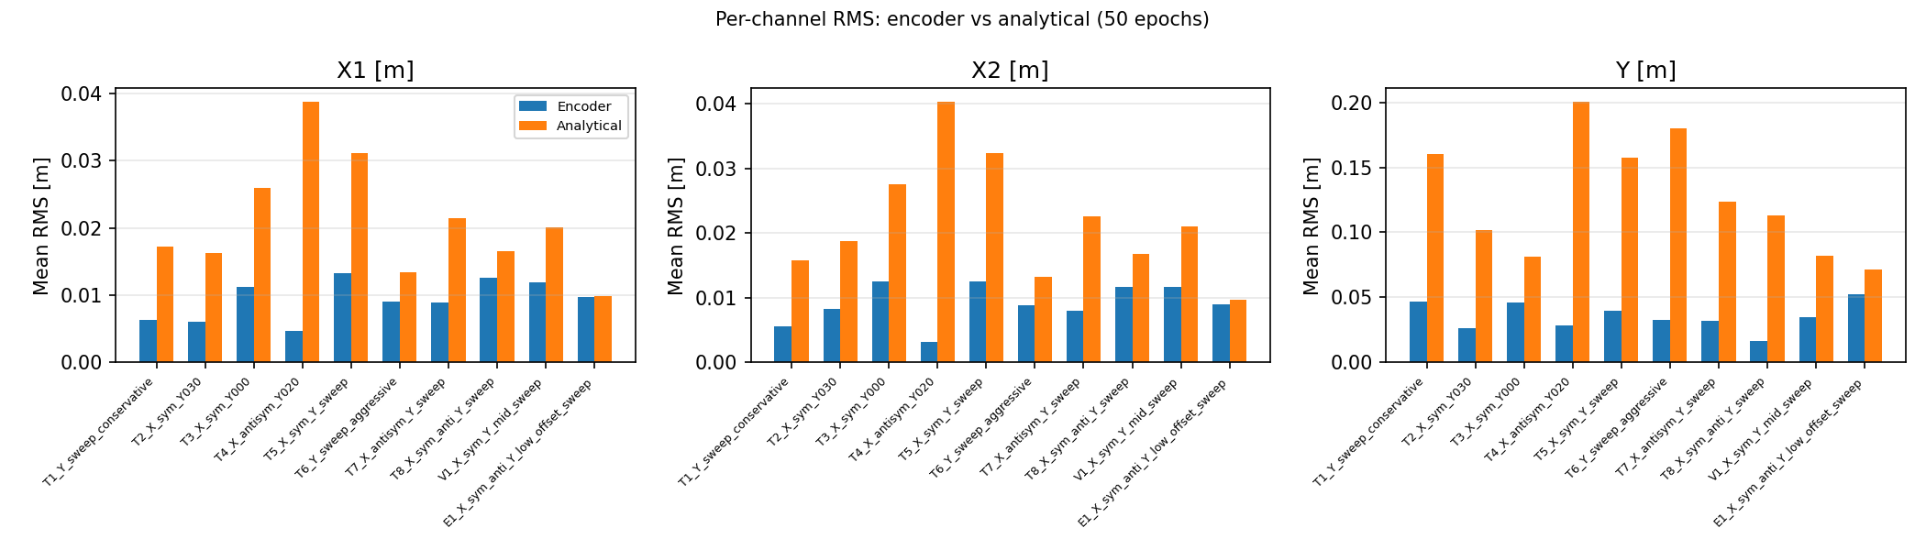
Trajectories divided into windows
For each window compute per-channel RMS over rollout steps
Average those per-window RMS values across windows
Notes:
For each trajectory, for each output channel (X1, X2, Y): the mean RMS error across all rollout
windows in that trajectory, comparing encoder-init vs analytical-init.
Concretely, for one bar:
1. Take all windows in that trajectory (up to 10, evenly spaced)
2. For each window, compute per-channel RMS: sqrt(mean((y_hat[:, ch] - y_ref[:, ch])^2)) over
the nf=350 rollout steps
3. Average those per-window RMS values across windows
So each bar = average rollout prediction error on one channel of one trajectory, over 350 steps
(0.35s at 1kHz).

Slide 54
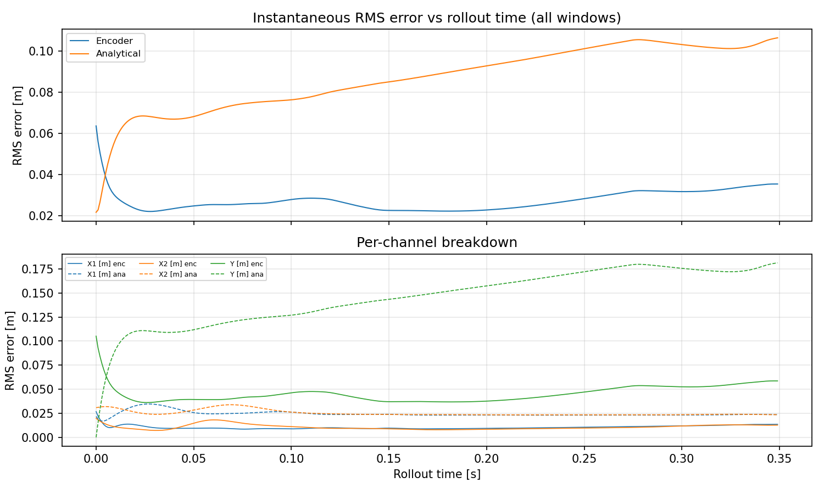
Notes:
What it tells you:
- How fast the prediction diverges from reality as you simulate
further from the initial state
- Whether the encoder gives a better starting point (lower
error at t=0) and whether that advantage persists or vanishes
over time
- If both curves converge to the same error after some steps,
the x0 difference washes out and the model dynamics dominate.
If they stay separated, the initial state quality matters
throughout the whole rollout horizon.

Slide 55
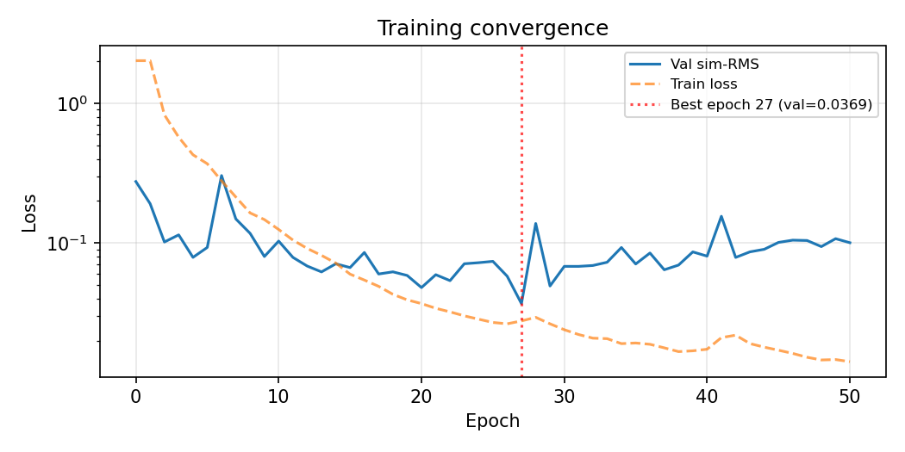

Slide 56
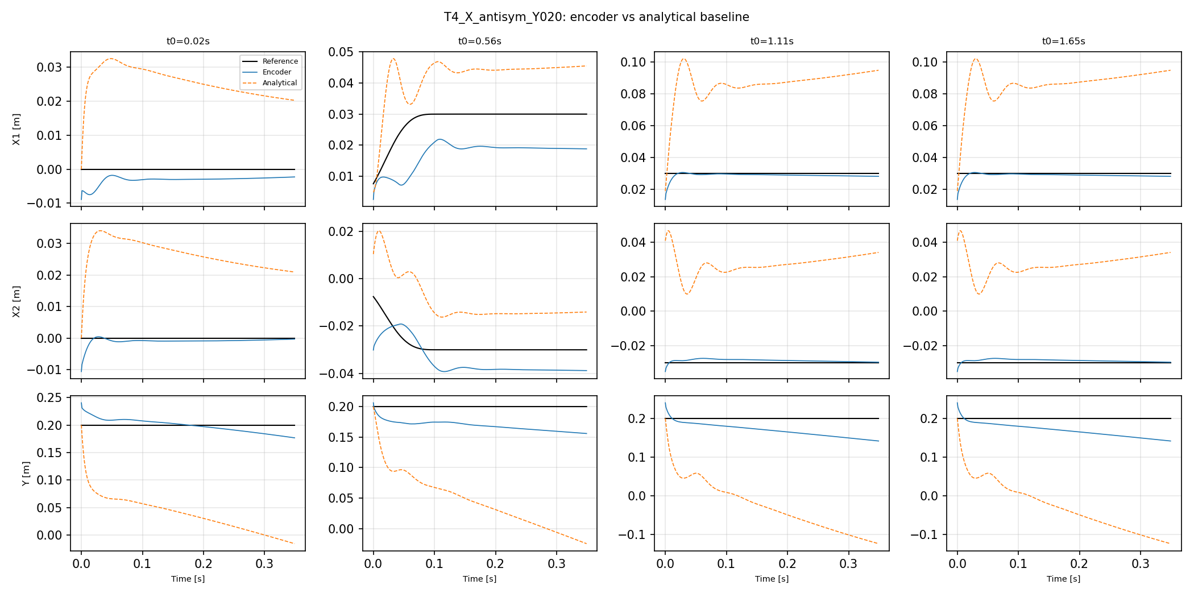

Slide 57
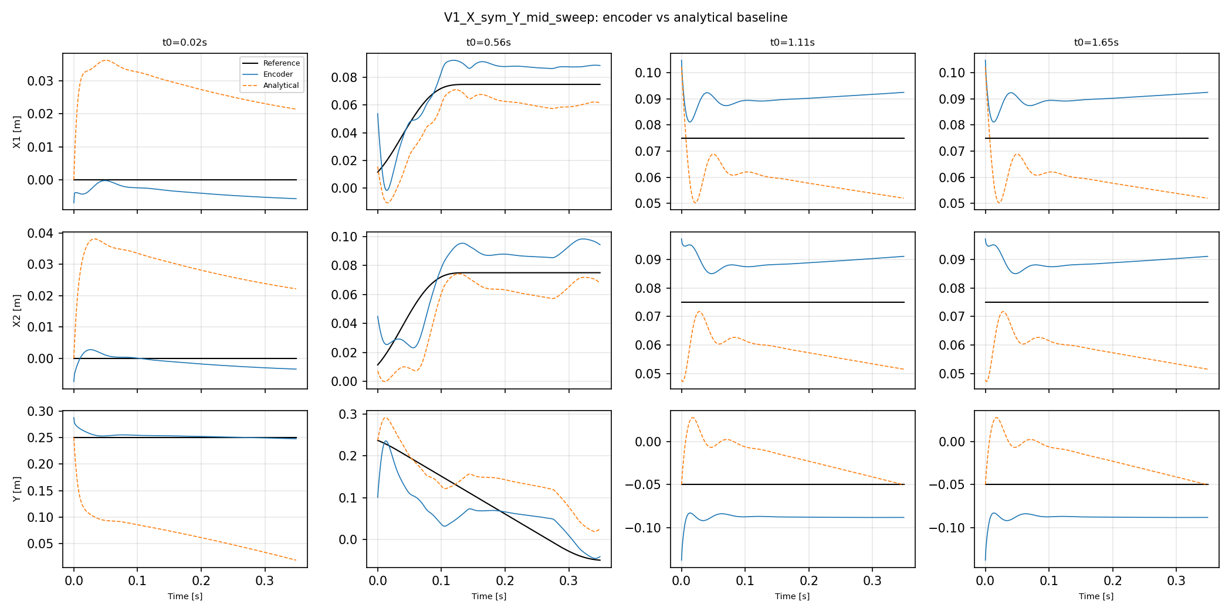

Slide 58
Outline next week
Update planning
  Complete planning
  If possible add gantry experiments
Verify that with the real physical angle constraints we can still recover the parameters
Augmentation additional states
  Low error

Slide 59
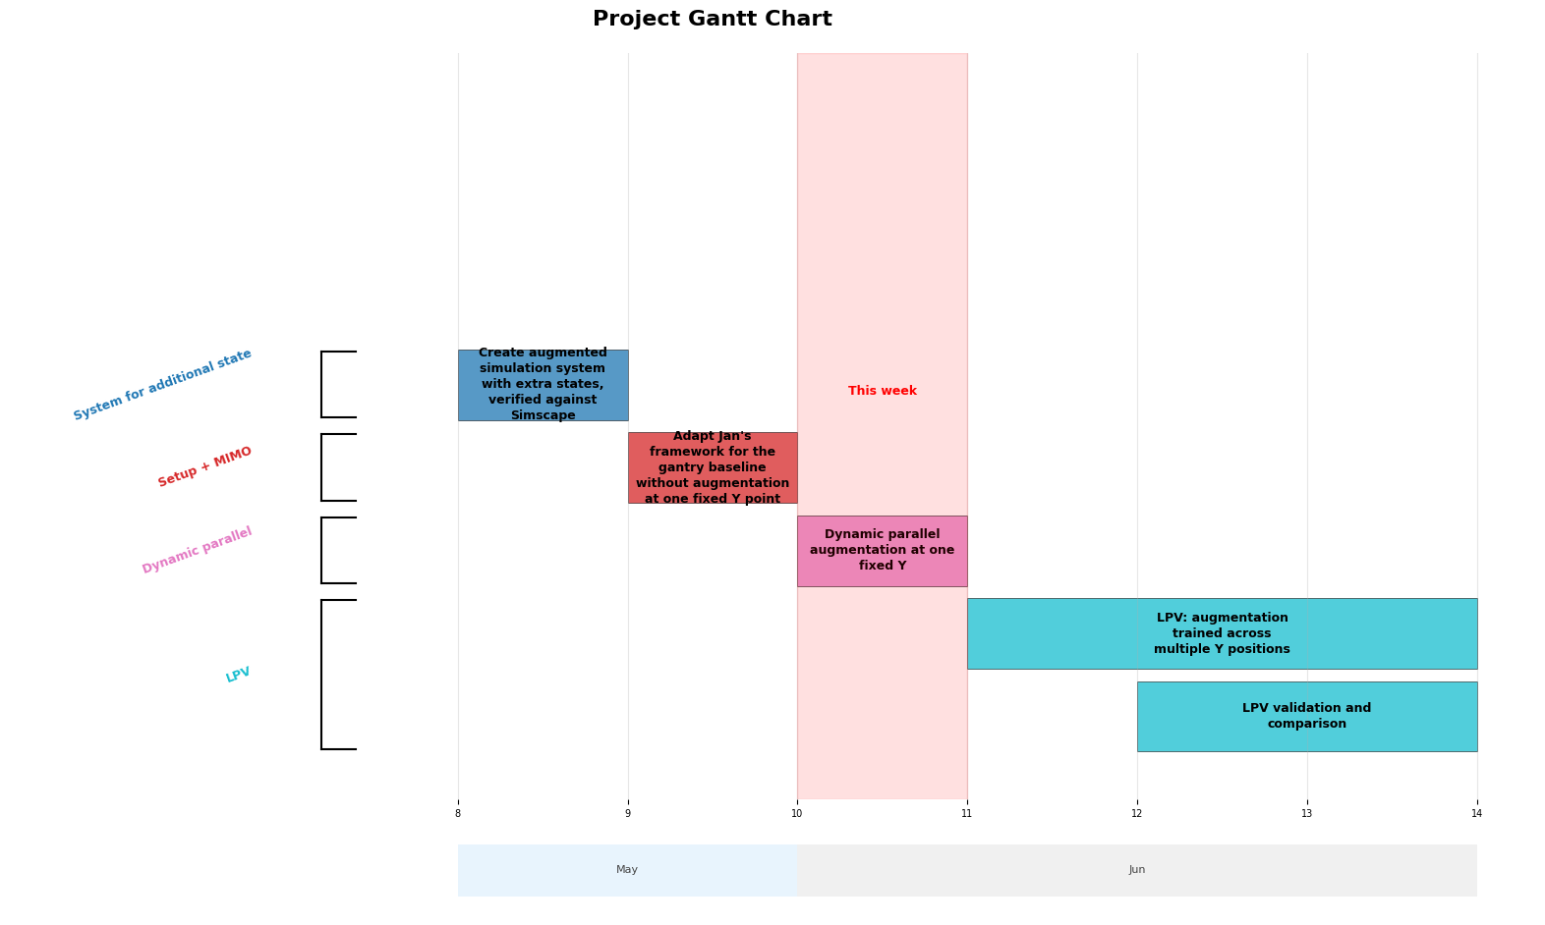

Slide 60
Was incorrectly normalizing stage coordinates, mismatch with logical coordinates used in the model

Slide 61
Baseline to compare encoder against
Next slide
Matches error matlab same input system with and without MSD with no encoder, windows, rollout
Encoder needs to improve over this baseline
Correct order of magnitude for the error (same as matlab input matching). Should be able to get in this range for the order of magnitude

Slide 62
job_id=65624
node_list=blade3
cpus_per_task=4
cuda_visible_devices=<unset>
Mon Jun 8 01:34:23 PM CEST 2026
=== CPU info ===
CPU(s): 64
On-line CPU(s) list: 0-63
Model name: AMD EPYC 7302 16-Core Processor
Thread(s) per core: 2
Core(s) per socket: 16
Socket(s): 2
NUMA node0 CPU(s): 0-15,32-47
NUMA node1 CPU(s): 16-31,48-63
=== gantry_subnet_verification CPU ===
Gym has been unmaintained since 2022 and does not support NumPy 2.0 amongst other critical functionality.
Please upgrade to Gymnasium, the maintained drop-in replacement of Gym, or contact the authors of your software and request that they upgrade.
Users of this version of Gym should be able to simply replace 'import gym' with 'import gymnasium as gym' in the vast majority of cases.
See the migration guide at https://gymnasium.farama.org/introduction/migration_guide/ for additional information.
Loaded 8 training + 1 val + 1 test trajectories
Building Config A: physics only (nxd=6)
Building Config B: physics + inert ANN (nxd=8)
======================================================================
Windowed rollout evaluation (nf=350 steps = 0.350 s)
======================================================================
Trajectory Win A:X1 A:X2 A:Y B:X1 B:X2 B:Y maxdiff
-----------------------------------------------------------------------------------------------------------------------
T1_Y_sweep_conservative.mat 4 0.000000 0.000000 0.000243 0.000000 0.000000 0.000243 0.00e+00
T2_X_sym_Y030.mat 4 0.000514 0.000512 0.000014 0.000514 0.000512 0.000014 0.00e+00
T3_X_sym_Y000.mat 4 0.000520 0.000506 0.000014 0.000520 0.000506 0.000014 0.00e+00
T4_X_antisym_Y020.mat 4 0.000044 0.000037 0.000055 0.000044 0.000037 0.000055 0.00e+00
T5_X_sym_Y_sweep.mat 4 0.000389 0.000378 0.000332 0.000389 0.000378 0.000332 0.00e+00
T6_Y_sweep_aggressive.mat 4 0.000000 0.000000 0.000449 0.000000 0.000000 0.000449 0.00e+00
T7_X_antisym_Y_sweep.mat 4 0.000040 0.000036 0.000393 0.000040 0.000036 0.000393 0.00e+00
T8_X_sym_anti_Y_sweep.mat 4 0.000239 0.000245 0.000232 0.000239 0.000245 0.000232 0.00e+00
V1_X_sym_Y_mid_sweep.mat 4 0.000306 0.000298 0.000263 0.000306 0.000298 0.000263 0.00e+00
E1_X_sym_anti_Y_low_offset_sweep.mat 4 0.000298 0.000297 0.000195 0.000298 0.000297 0.000195 0.00e+00
======================================================================
SUMMARY
======================================================================
Overall mean RMS per channel (Config A, physics only):
X1: 0.000235 m X2: 0.000231 m Y: 0.000219 m
Overall mean RMS per channel (Config B, physics + inert ANN):
X1: 0.000235 m X2: 0.000231 m Y: 0.000219 m
Max A-vs-B difference: 0.00e+00 m
PASS: Config A and B are identical (ANN is truly inert)
Expected range: ~1e-04 m per channel (from MATLAB MSD comparison)
X1: 2.35e-04 m = 2.4x target
X2: 2.31e-04 m = 2.3x target
Y: 2.19e-04 m = 2.2x target

Slide 63
Does the encoder keep improving with the ANN for estimation of the additional states (Augmentation)…?

Slide 64
Float64 vs float32

Slide 65
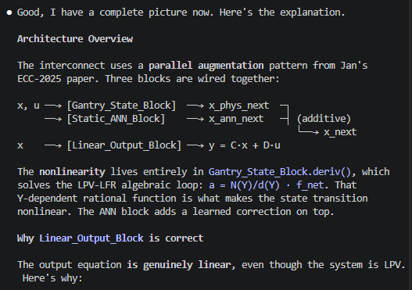
The selection matrix at the output block is a separate,
independent choice: do augmented states appear in the
observation equation? You could have parallel augmentation
where augmented states do appear in the output (extend C to
include columns for x_ann), or where they don't (current
setup). Either way it's still parallel, because the defining
feature is the additive state update, not what the output
block sees.

Slide 67
Analytical baseline
Problem encoder
  Hybrid encoder
Multisine?
Downsampling
NF NA_NB
How did I implement the current structure
PLANNING UPDATE…

Slide 68
Good results. Let me address your questions.
The dlyap error: Two eigenvalues are exactly at z=1.0 (the integrator modes, X and Y rigid-body translation with zero stiffness). The discrete
Lyapunov equation requires all eigenvalues strictly inside the unit circle. Not a bug in the script, just a property of the system. We can either
skip the Gramian or stabilize those modes with a tiny damping. But honestly, the PBH test and per-mode observability already give us what we need.
The Gramian is redundant here.
Is the method clean for deriving fs, nf, na_nb?
It's correct but overcomplicated. Here's what the eigenvalue table already tells us in plain language:
- fs: Fastest mode is MSD at 158 Hz. Nyquist says fs > 316 Hz. With 10x RK4 sub-stepping that's the same bound. fs=4000 Hz is 12.7x oversampled.
Done.
- nf: MSD settling time is 95 ms. The loss needs to see at least one full ring-down. At 4000 Hz that's 382 samples. Current nf=1200 (300 ms) is 3x
more than needed. Done.
- na_nb: MSD period is 6.3 ms. The encoder needs to see at least a couple of oscillation cycles to estimate phase and amplitude. Two periods = 12.8
ms = 51 samples. Current na_nb=400 (100 ms) is 8x more than the minimum. Done.
That's it. Three numbers from eig(A_c). The FRF and observability sections answer different questions (is the MSD visible? can it be observed?) but
they don't change the hyperparameter derivation. They're useful context for interpreting training results later, but for the hyperparameter
justification itself, Section 1 alone is sufficient.
The simpler version: eigenvalues give natural frequencies and time constants. Natural frequencies set fs. Settling time sets nf. Oscillation period
sets na_nb. Three lines of reasoning, each one sentence. The rest (FRF, PBH, Gramian) is supporting evidence for the thesis, not for hyperparameter
selection.
Do you want me to trim the script to just the eigenvalue section + summary, and keep the FRF/observability as a separate diagnostic?

Slide 72
Structure used and how copied
  RK4
Determine downsampling, nf na nb, rk4 steps
Encoder cant compete with analytical baseline
  Hybrid encoder?
  Analytisch laten zien, cant beat that… for augmented system
Data not informative enough? Added multisine as solution
Look at gantry_test_diagnose_default_encoder_65974.out!!
Laten zien met MSD informative enough… of ene plot mismatch al??

